Slide 1
Digital Concept and Overview
Part 2
Course : CPEN6265010 Digital System
Effective Period : September 2025

Slide 2
Related LO
Learning Objectives
LO1: Analyze and Design Combinational Logic Circuits.

Slide 3
Outlines
Fixed-Function Logic Devices
Test and Measrurement Instruments
Introduction to Troubleshooting

Slide 4
Fixed Function Logic Devices
Fixed-function logic and programmable logic are two broad categories of digital ICs.
In fixed-function logic devices, the logic functions are set by the manufacturer and cannot be altered.
Cutaway view of one type of fixed-function IC package (dual in-line package) showing the chip mounted inside, with connections to input and output pins.

Slide 5
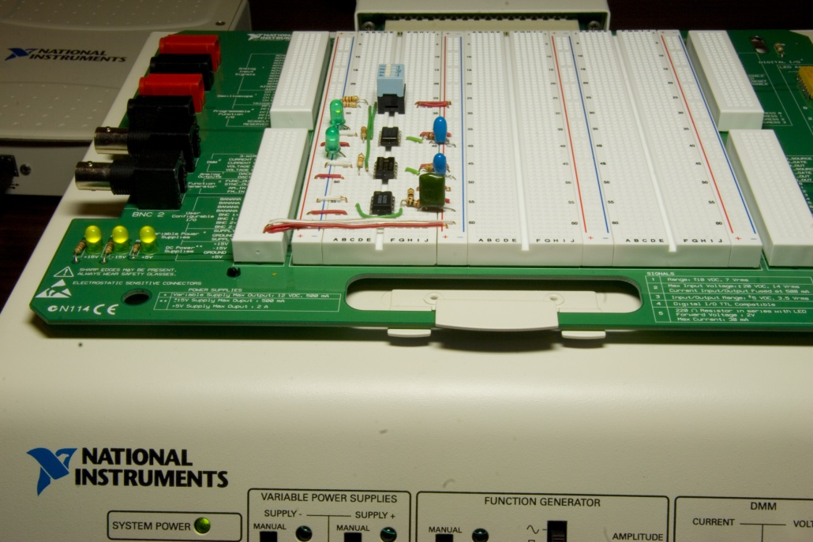
Fixed Function Logic Devices
An example of laboratory prototyping is shown. The circuit is wired using DIP chips and tested.
In this case, testing can be done by a computer connected to the system.
DIP chips

Slide 6
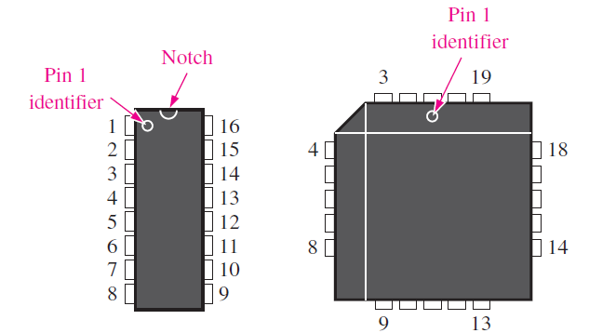
Fixed Function Logic Devices
Pin numbering for two examples of standard types of IC packages. Top views are shown.
Other surface mount packages:
SOIC PLCC LCCC

Slide 7
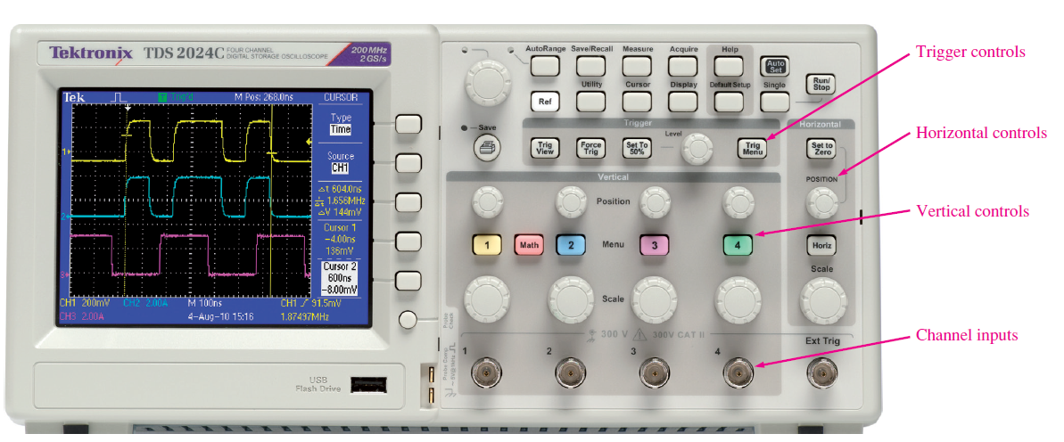
Test and Measurement Instrument
A typical digital oscilloscope front panel. Numbers below screen indicate the values for each division on the vertical (voltage) and horizontal (time) scales and can be varied using the vertical and horizontal controls on the scope.
Used with permission from Tektronix, Inc.

Slide 8
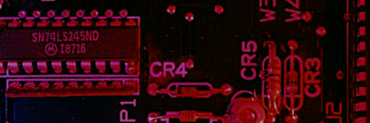

For measuring digital signals, use DC coupling
Summary
Test and Measurement Instruments
Normally, trigger on the slower of two waveforms when comparing signals.

Slide 9
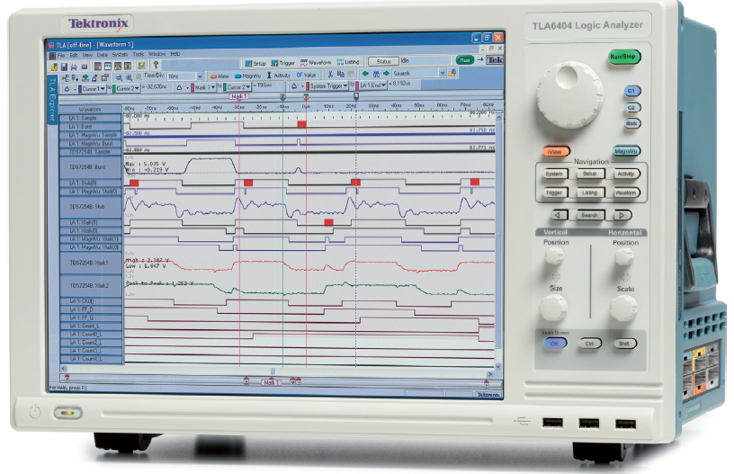
Test and Measurement Instrument
Logic analyzers are used for measurements of multiple digital signals and measurement situations with difficult trigger requirements. Logic analyzer came about as a result of microprocessors in which troubleshooting or debugging required many more inputs.
Used with permission from Tektronix, Inc.

Slide 10
Introduction to Troubleshooting
Troubleshooting is the process of recognizing, isolating, and correcting a fault or failure in a system.
To be an effective troubleshooter, you must understand how the system works and be able to recognize incorrect performance.
Troubleshooting can be at the system level, the circuit board level, or the component level.
Today, troubleshooting down to the board level is usually sufficient. Once a board is determined to be defective, it is usually replaced with a new one.
However, if the circuit board is to be saved, component-level troubleshooting may be necessary.

Slide 11
Introduction to Troubleshooting
Basic Hardware Troubleshooting Methods.
  As a general guide to troubleshooting a system, the following steps should be followed:
    Gather information on the problem.
    Identify the symptoms and possible failures.
    Isolate point(s) of failure.
    Apply proper tools to determine the cause of the problem.
    Fix the problem.
Check the Obvious: After collecting information on the problem, make sure to first check for obvious faults
Replacement: Assume that a given system has multiple circuit boards. The simplest and quickest way to fix a problem is by replacing the circuit boards one by one with a known good board until the problem is corrected.

Slide 12
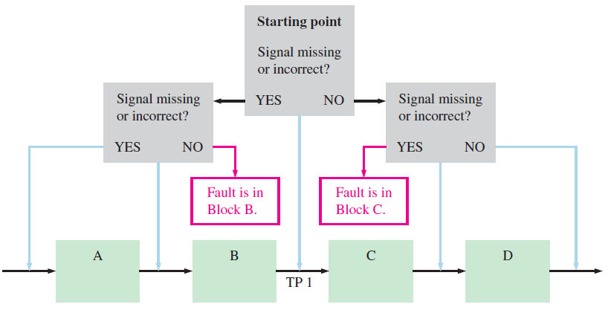
Introduction to Troubleshooting
Reproducing the Symptoms: Once the symptoms of a faulty system are identified, find a way to reproduce the problem. If the problem can be reproduced, it can be isolated and resolved. Always consider the possibility that there is more than one fault.
Half-Splitting Method: In this procedure, you check for the presence or absence of a signal at a point halfway between input and output. If the signal is present, you know the fault is in the second half. If the signal is absent, you know the fault is in the first half.

Slide 13
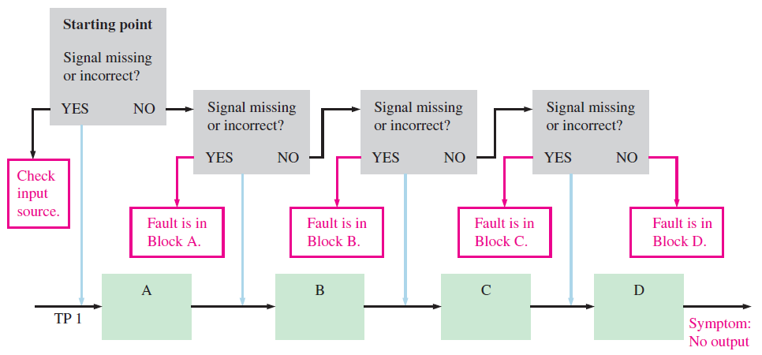
Introduction to Troubleshooting
Signal-Tracing Method: Signal tracing is the procedure of tracking signals as they progress through a system from input to output. Signal tracing can be used with half-splitting, where you check for a signal at each point from where the absence of a signal was detected.

Slide 14
Exercise
Name two advantages of digital data as compared to analog data.
Form a single logical statement from the following information:
(a) The light is ON if SW1 is closed.
(b) The light is ON if SW2 is closed.
(c) The light is OFF if both SW1 and SW2 are open.
A pulse waveform with a frequency of 20 kHz is applied to the input of a counter. During 40 ms, how many pulses are counted?
Give some examples of the type of information that you look for when a system is reported to have failed.

Slide 15
References
Null, Linda (2024). "The essentials of computer organization and architecture". 6th edition. Jones & Bartlett Learning, Burlington, Massachusetts. ISBN: 9781284259438..
Thomas L. Floyd. (2014). “Digital Fundamentals”. 11th Edition. Prentice Hall. New Jersey. ISBN: 978-0132737968.
Basic Gates and Functions : http://www.ee.surrey.ac.uk/Projects/CAL/digital-logic/gatesfunc/index.html

